Slide 1
FORECAST EXCHANGE RATES PROJECT - 63 [ TEAM- 6 ]
Project Members:
Sangamesh Murgad
Sanjana Patil
Snehal Shegokar
Swapnil Joshi
Sangharsh Patil
Vrushabh Rode
Sagar Nagarale
Project Mentor: Varun sir
Date:

Slide 2
CURRENCY EXCHANGE BACKGROUND
In order to facilitate the exchange of goods and services, between the countries, all the governments across the world, agreed set USD as an international currency. Making USD as an universally accepted and preferred currency for international trade.
Banks and other Registered currency traders act as intermediaries in currency exchange market.
There are 4 Currencies exchanges, namely, Tokyo, Sydney, London, New York.
Currency exchange transactions are facilitated, 24/7 through these exchanges. However, no trading happens on Saturday and Sunday and Public holidays.
Currency exchange rates are determined by demand and supply in the market. However, there are multiple factors that affect the demand and supply of any given currency.
Only factor that can directly impact the exchange rates are by political interventions. such as currency devaluation by the federal government of that country.
BUISNESS OBJECTIVE
The objective is to understand the underlying structure in dataset, and come up with a suitable, time based forecasting model, which can effectively forecast USD/INR exchange rate for next 30 days to 60 days.
STATISTICAL PROBLEM
This is a REGRESSION problem

Slide 3
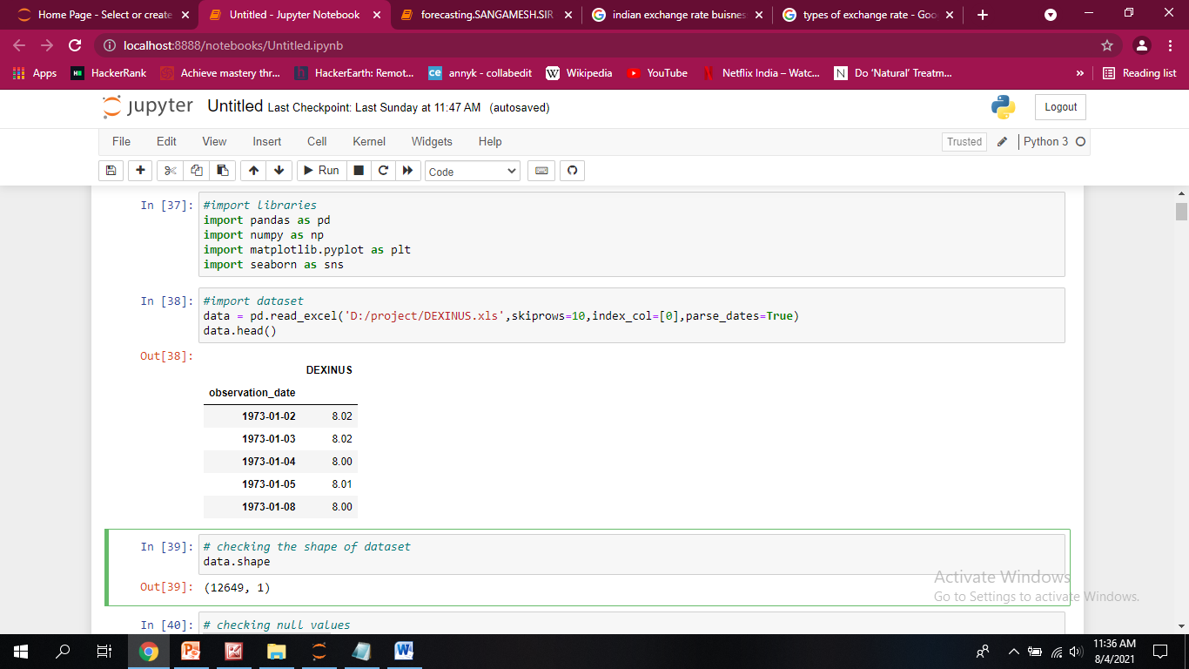
Introduction to DATA
checking shape of dataset = (12649, 1)
checking null value's = 494
Duration of years = [1973-2021] 47.5
Missing values in the data are because of:
The currency exchange markets are closed on Saturday and Sunday and on public holidays as declared by the Federal Bank of America.

Slide 4
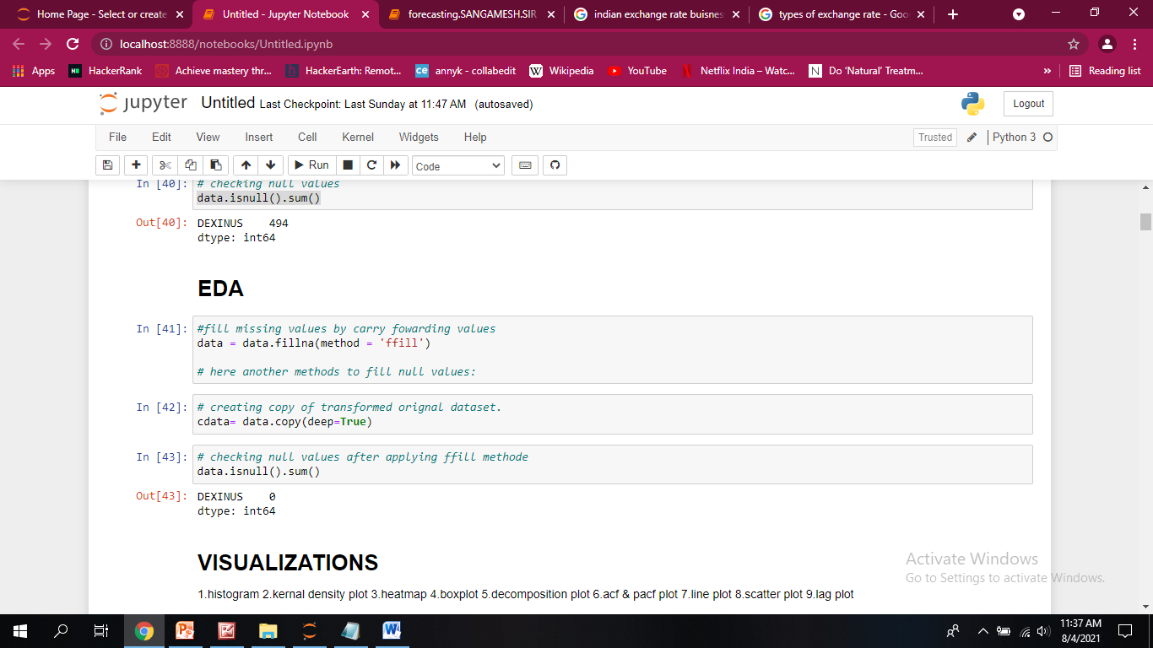
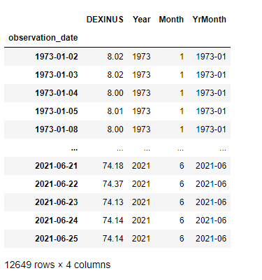
Data Precessing
Types of Methods to fill missing values:
fillna() = method{‘backfill’, ‘bfill’, ‘pad’, ‘ffill’, None}
replace()
interpolate()
dropna()
Fabrication of new columns =>

Slide 5
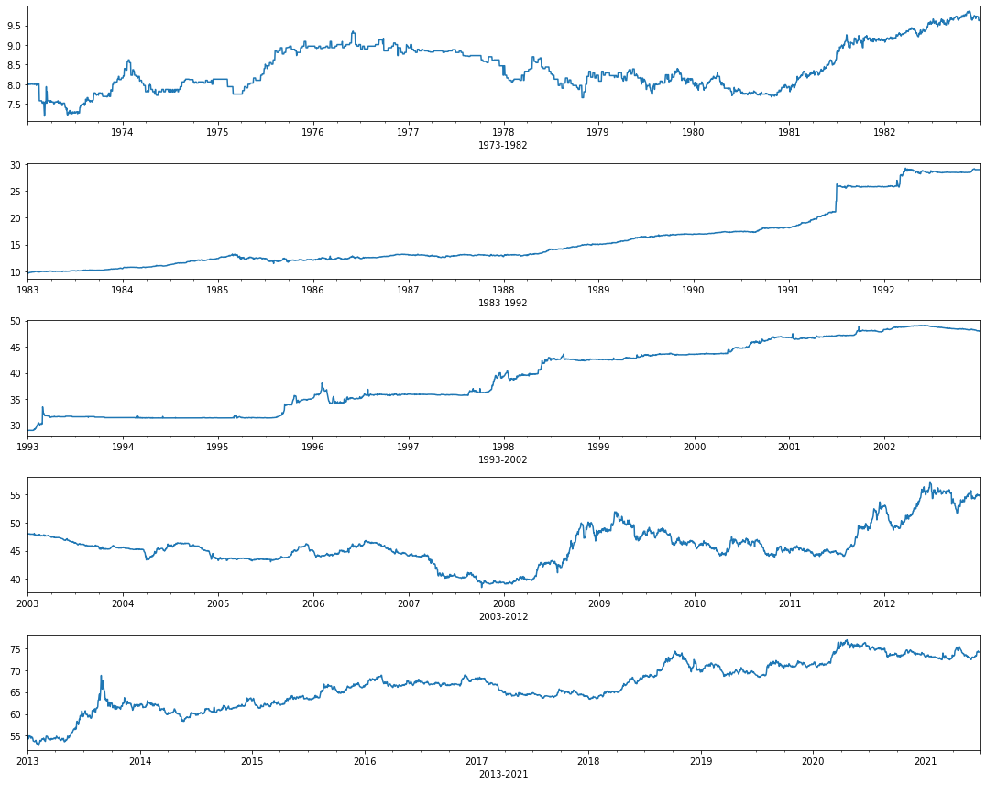
10 YEAR - Line Plot
WE HAVE TOTAL 47.5 YEARS OF DATA FOR ANALYSIS. HENCE, CHOSE TO STUDY - INTERVAL OF 10 YEARS TO START WITH
For the first 10 years the trend is almost flat and zero variations.
For next 10 years the trend is slightly incremental and no variations for majority of the years. we can only see the increase in the last two years of the decade.
For Third decade the trend is incremental and there are minor variations.
For last decade we can see the trend is incremental and there are strong fluctuation in the data.

Slide 6
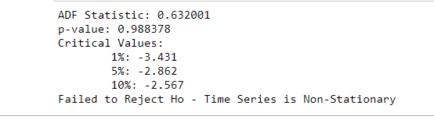
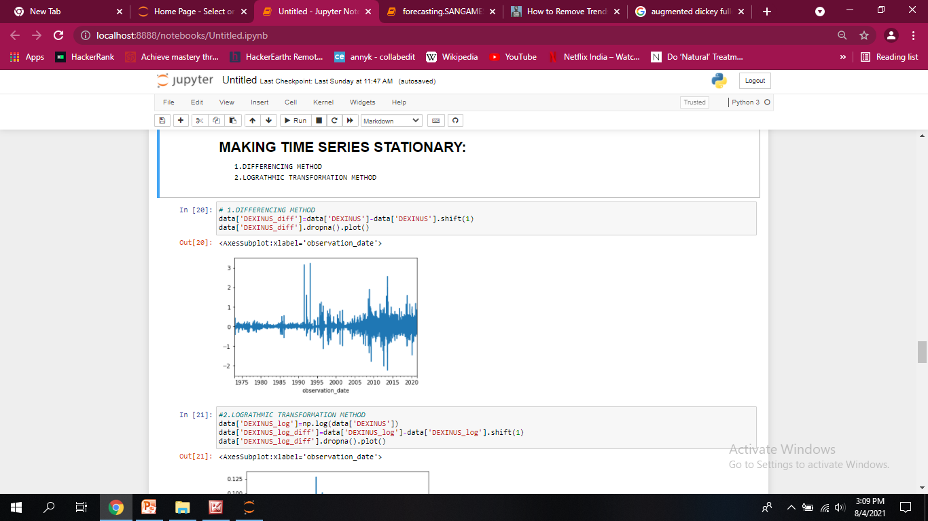
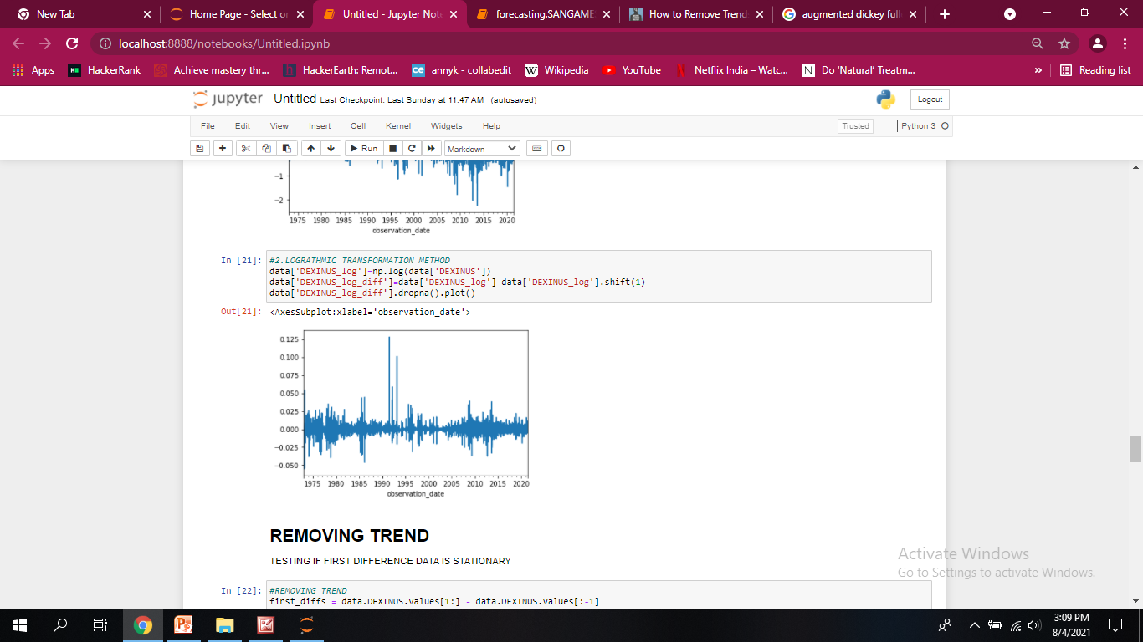
CHECKING FOR STATIONARITY
Augmented dickey fuller test

Slide 7
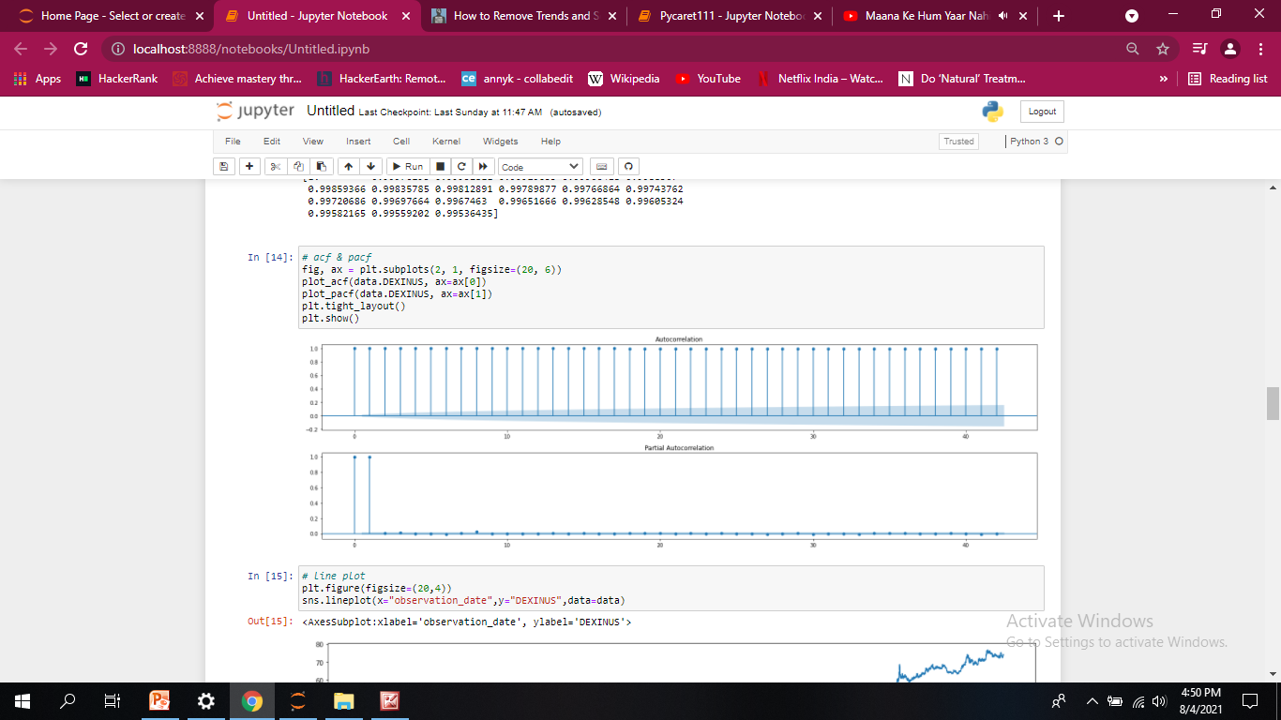
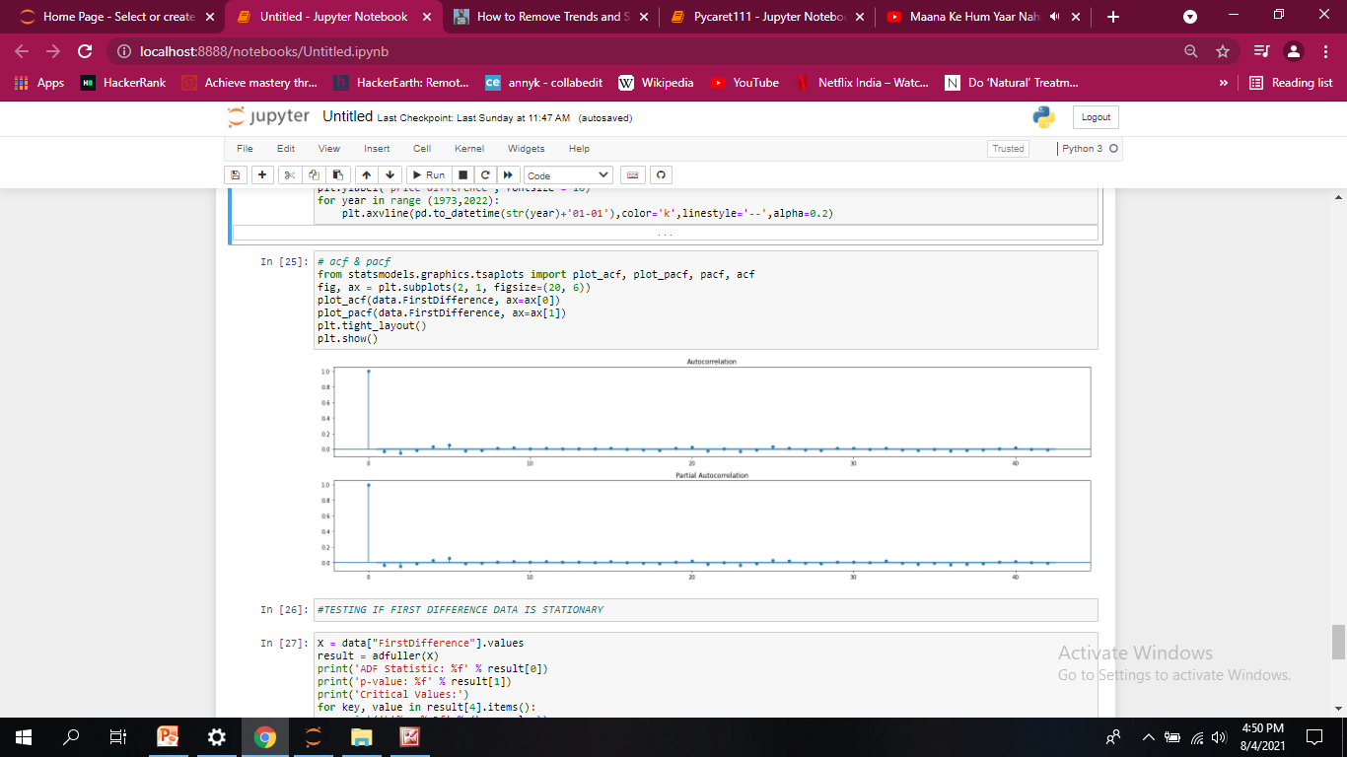
ACF & PACF PLOT
Before making stationary
After making stationary

Slide 8
MODELS BUILT
So, To start with we worked on building simple models and increased the complexity of models gradually. So the models like Simple treditional models using smooting techniques are too simple/naive to address the complex problem of predicting exchange rate. Following are the models taken for discussion.
Naive models
Smoothing models
ARIMA, SERIMA, SERIMAX
FB_PROPHET
ANN
LSTM
GRU

Slide 9
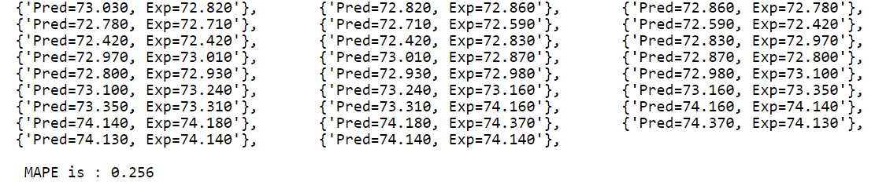
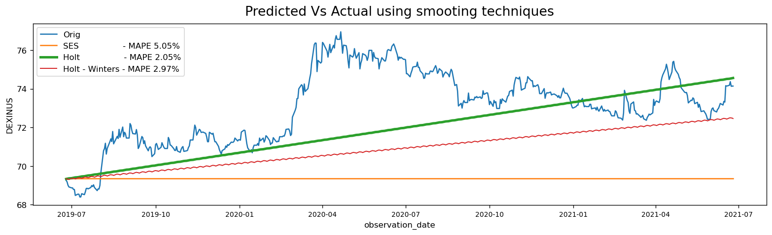
Naive Models
Predicting Todays Price as Tomorrows Price
Prediction using smoothing techniques

Slide 10
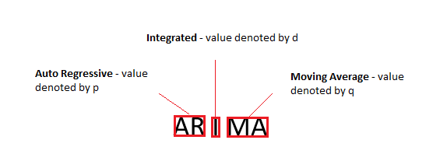
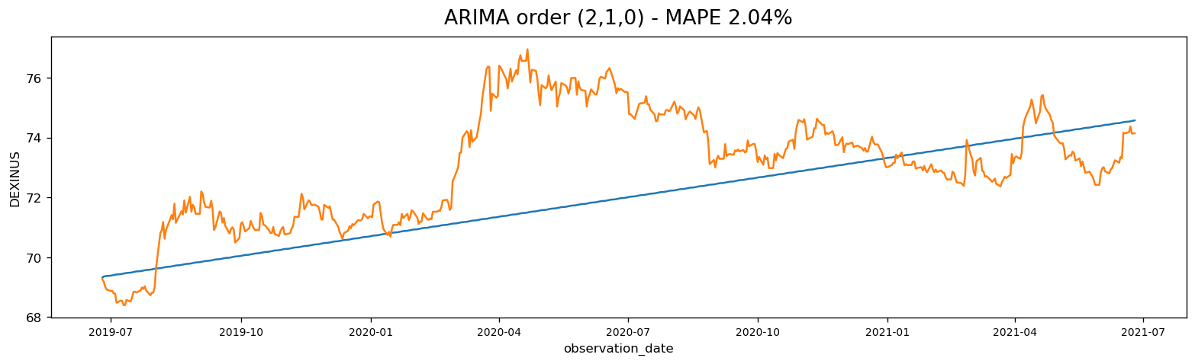
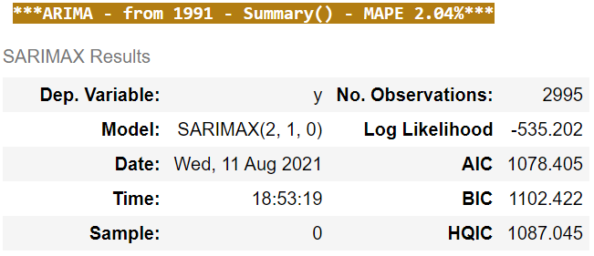
ARIMA, SERIMA, SERIMAX (PMDARIMA)

Slide 11
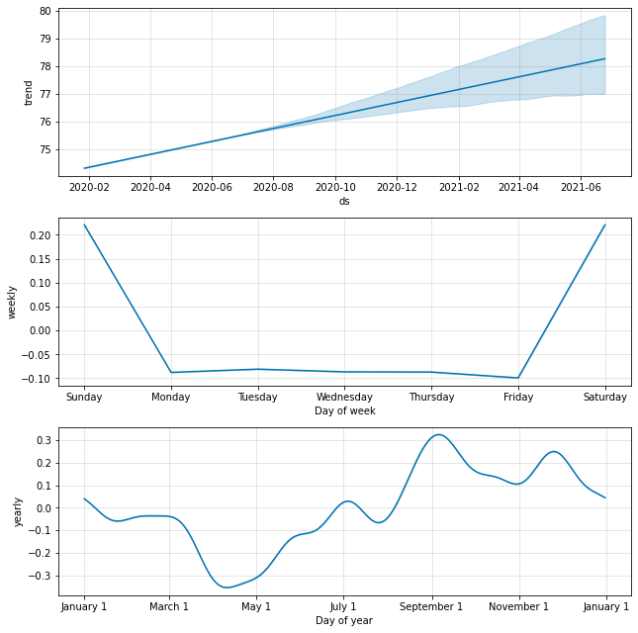
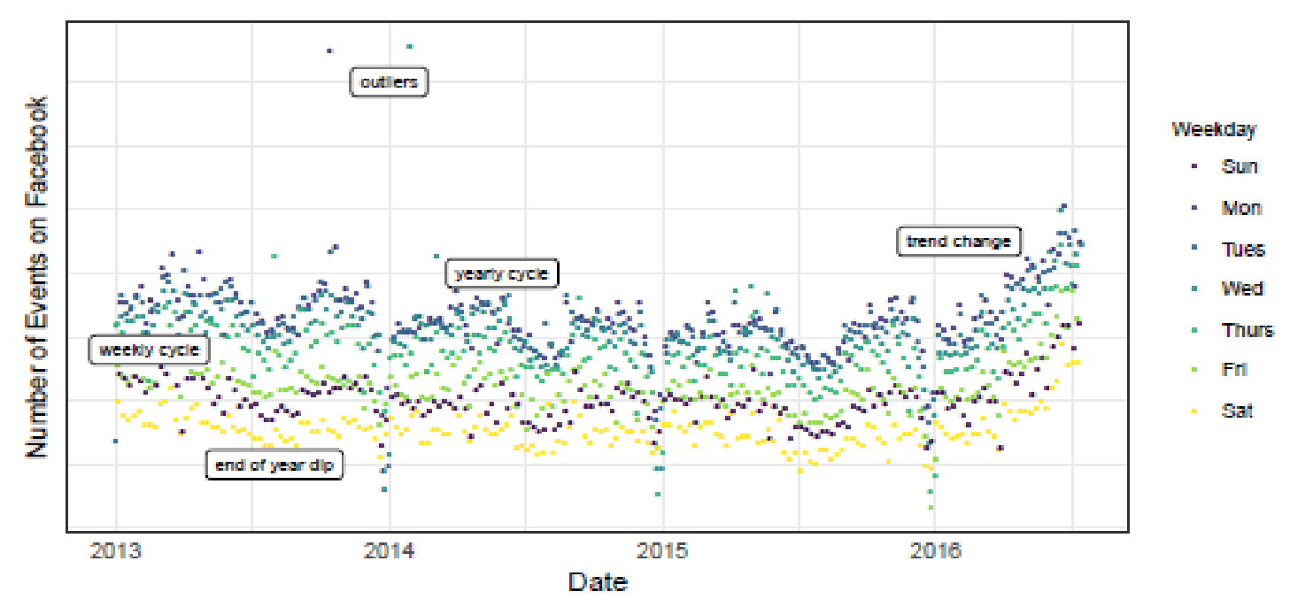
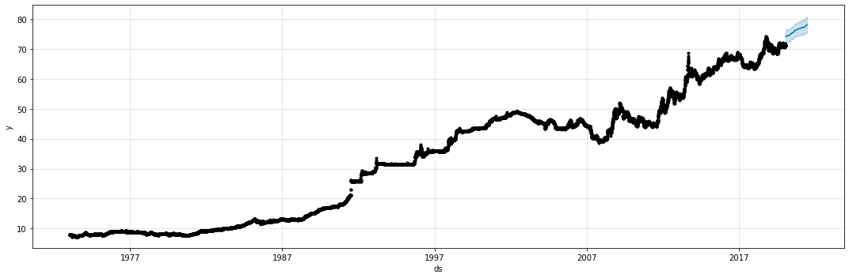
FB-PROPHET
SIMILER TO GAN (General Additive Model)
TREND MODEL + SEASONALITY MODEL + HOLIDAY EFFECT
Model Components
MAPE-1.49%

Slide 12
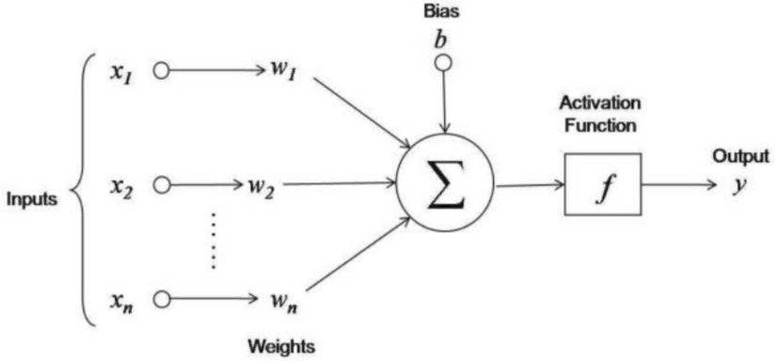
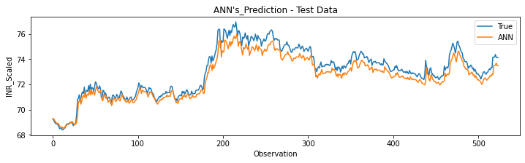
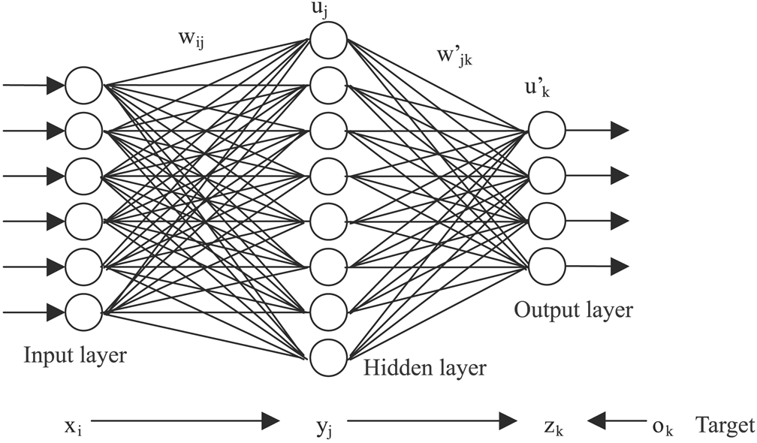
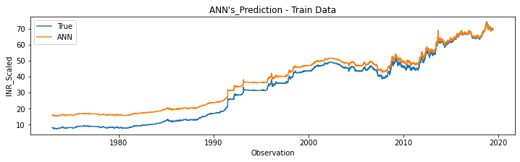
ANN
On Train Data
The R2 score on the Train set is : 0.926
The MAE on the Train set is : 4.769
The RMSE on the Train set is : 5.418
The MAPE on the Train Set is : 34.782%
On Test Data
The R2 score on the Test set is : 0.896
The MAE on the Test set is : 0.522
The RMSE on the Test set is : 0.608
The MAPE on the Test Set is : 0.708%
ANN Neuron
ANN NETWORK

Slide 13
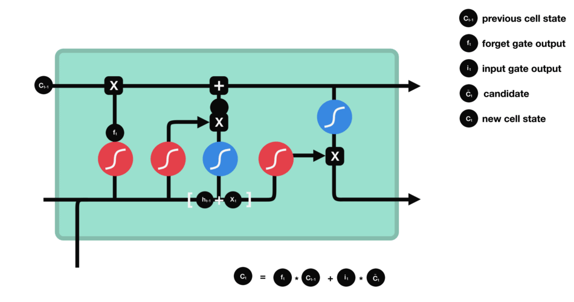
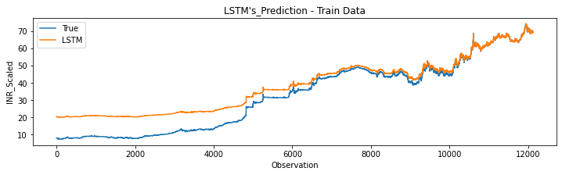
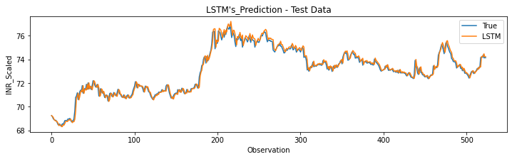
LSTM
The Scores on Train Data
The R2 score on the Train set is : 0.862
The MAE on the Train set is : 5.674
The RMSE on the Train set is : 7.413
The Adjusted R2 score on the Train set is : 0.862
The MAPE on Train set is : 48.880 %
The Scores on Test Data
The R2 score on the Test set is : 0.977
The Adjusted R2 score on the Test set is : 0.977
The MAE on the Test set is : 0.204
The RMSE on the Test set is : 0.284
The MAPE on the Test Set is : 0.279 %

Slide 14
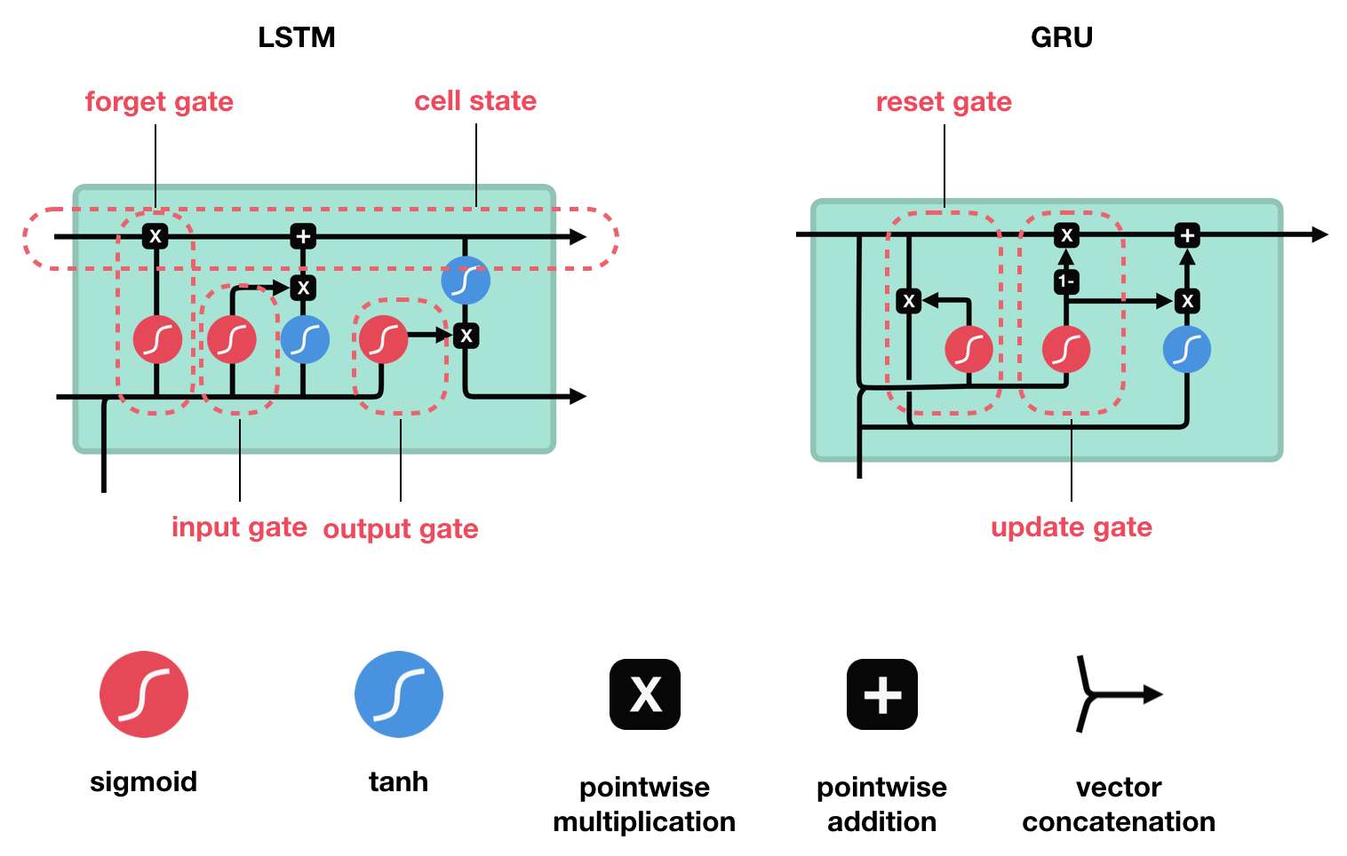
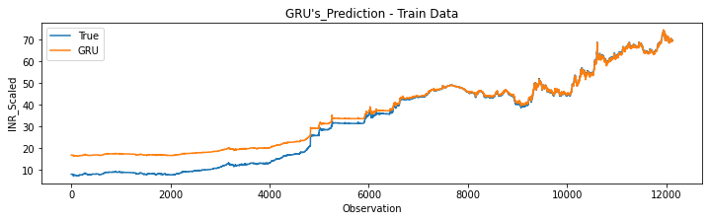
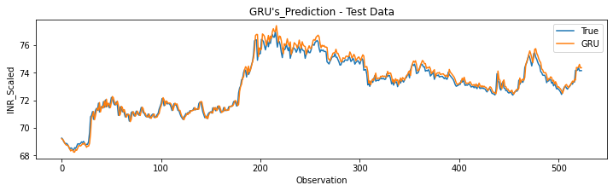
GRU
The Score on Train Data
The R2 score on the Train set is : 0.93
The MAE on the Train set is : 3.55
The RMSE on the Train set is : 5.05
The Adjusted R2 score on the Train set is : 0.93
The MAPE on the Train set is : 33.16%
The Score on Test Data
The R2 score on the Test set is : 0.96
The Adjusted R2 score on the Test set is : 0.96
The MAE on the Test set is : 0.24
The RMSE on the Test set is : 0.33
The MAPE on Test set is : 0.33%

Slide 15
MODEL SELECTION –ACCURACY BASED
Model Name | MAPE | Unit
Naive model Predicting todays price as tomorrows price | 0.24 | percent
Simple Exponential Smoothing - SES Model | 5.05 | percent
HOLT - Simple Exponential Smoothing - HOLT Model | 2.05 | percent
HOLT - Exponential Smooting - HOLT Winters model | 2.97 | percent
ARIMA - Order (2,1,0) | 2.04 | percent
FB-PROPHET | 1.49 | percent
Artificial Neural Networks - ANN | 0.73 | percent
RNN - Gated Recurrent Unit - GRU Model | 0.34 | percent
RNN - Long Short Term Memory - LSTM Model | 0.28 | percent

Slide 16
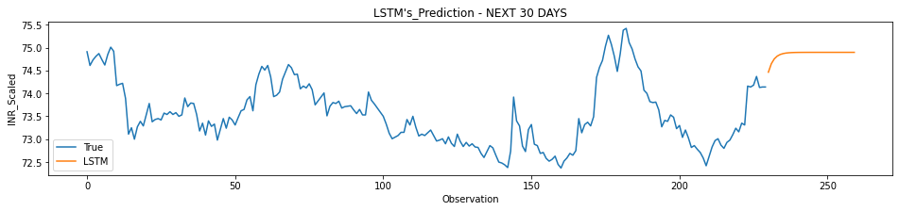
LSTM - FINAL MODEL
PREDICTED VALUES FOR NEXT 30 DAYS
-----------------------------------------------------------
74.46319633483888
74.64825317382814
74.75432426452637
74.815131149292
74.85001693725587
74.87000869750977
74.88147651672364
74.88807113647462
74.89185493469239
74.89401710510255
74.89525619506837
74.89597137451173
74.89637886047365
74.8966033935547
74.89674476623536
74.89681961059571
74.89686950683594
74.89689445495607
74.89691108703614
74.89691940307618
74.89692771911622
74.89693603515626
74.89693603515626
74.89693603515626
74.89693603515626
74.89693603515626
74.89693603515626
74.89693603515626
74.89693603515626
74.89693603515626

Slide 17
Actual Vs Prediction (28th Jun to 6th Aug)
DATE | DEXINUS | PREDICTION | ERROR |  | DATE | DEXINUS | PREDICTION | ERROR
28-06-2021 | 74.29 | 74.46 | -0.17 |  | 19-07-2021 | 74.85 | 74.90 | -0.05
29-06-2021 | 74.29 | 74.65 | -0.36 |  | 20-07-2021 | 74.60 | 74.90 | -0.30
30-06-2021 | 74.33 | 74.75 | -0.42 |  | 21-07-2021 | 74.49 | 74.90 | -0.41
01-07-2021 | 74.56 | 74.82 | -0.26 |  | 22-07-2021 | 74.46 | 74.90 | -0.44
02-07-2021 | 74.51 | 74.85 | -0.34 |  | 23-07-2021 | 74.44 | 74.90 | -0.46
05-07-2021 | 74.51 | 74.87 | -0.36 |  | 26-07-2021 | 74.35 | 74.90 | -0.55
06-07-2021 | 74.58 | 74.88 | -0.30 |  | 27-07-2021 | 74.50 | 74.90 | -0.40
07-07-2021 | 74.81 | 74.89 | -0.08 |  | 28-07-2021 | 74.52 | 74.90 | -0.38
08-07-2021 | 74.76 | 74.89 | -0.13 |  | 29-07-2021 | 74.25 | 74.90 | -0.65
09-07-2021 | 74.53 | 74.89 | -0.36 |  | 30-07-2021 | 74.34 | 74.90 | -0.56
12-07-2021 | 74.56 | 74.90 | -0.34 |  | 02-08-2021 | 74.35 | 74.90 | -0.55
13-07-2021 | 74.51 | 74.90 | -0.39 |  | 03-08-2021 | 74.25 | 74.90 | -0.65
14-07-2021 | 74.54 | 74.90 | -0.36 |  | 04-08-2021 | 74.15 | 74.90 | -0.75
15-07-2021 | 74.55 | 74.90 | -0.35 |  | 05-08-2021 | 74.10 | 74.90 | -0.80
16-07-2021 | 74.61 | 74.90 | -0.29 |  | 06-08-2021 | 74.19 | 74.90 | -0.71

Slide 18
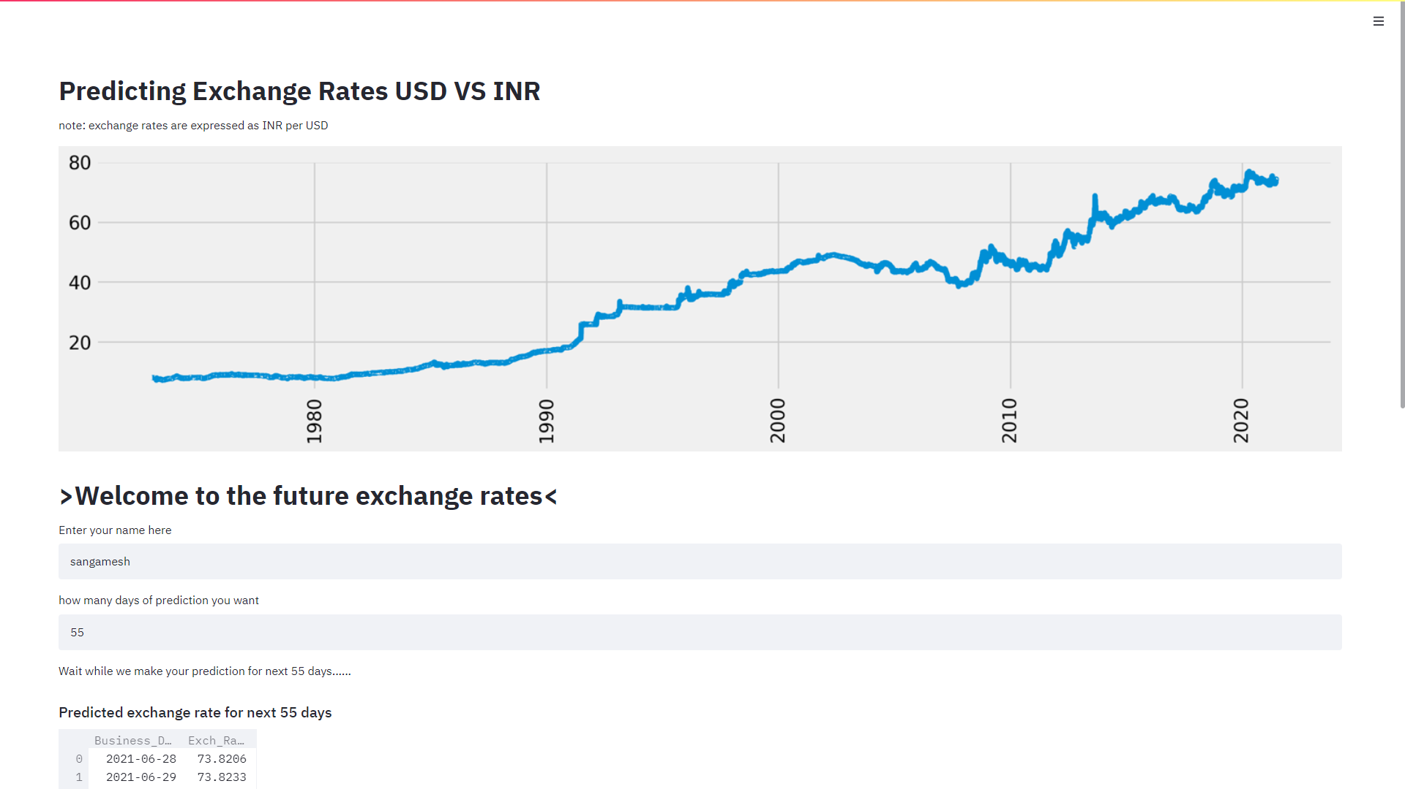
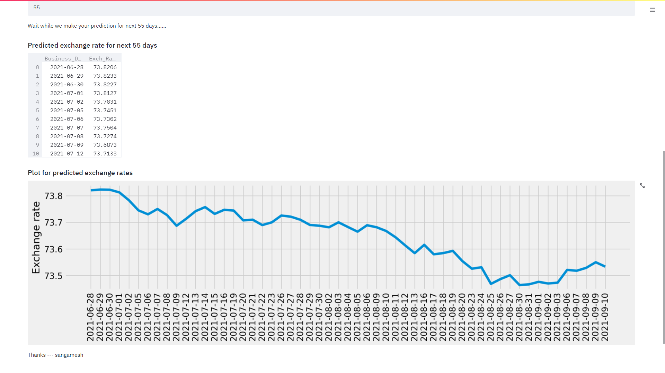
DEPLOYMENT
We have deployed it on by creating a Rest API using stream lit. below is the screen shot of the UI.

Slide 19
Thakyou

